Slide 1
Wallet Payment Application
Pecunia Bank

Slide 2
Problem Statement
To create payment wallet application for Pecunia bank.
Customers will be able to park their money in the wallet.
Customer should be able to pay different bills using this wallet.
They should be able to connect bank account with this payment wallet and add money.
Application should allow customers to check the balance, deposit money etc.

Slide 3
Road Map
Application will be developed in following Sprints –
Core Java +JPA with Hibernate
Spring Boot + Rest Controller + JPA with Hibernate
Angular for UI design (Front End) + Integration with Spring based Restful service

Slide 4
Plan
Design
Generate the skeleton as per class design provided
TDD approach
Identify test cases for each module
Write Failing Test cases
Convert the Test Cases in GREEN

Slide 5
Modules
Bill Payment Module
Account
Module
Customer Module
Transaction Module
Beneficiary Module
BankAccount
Module

Slide 6
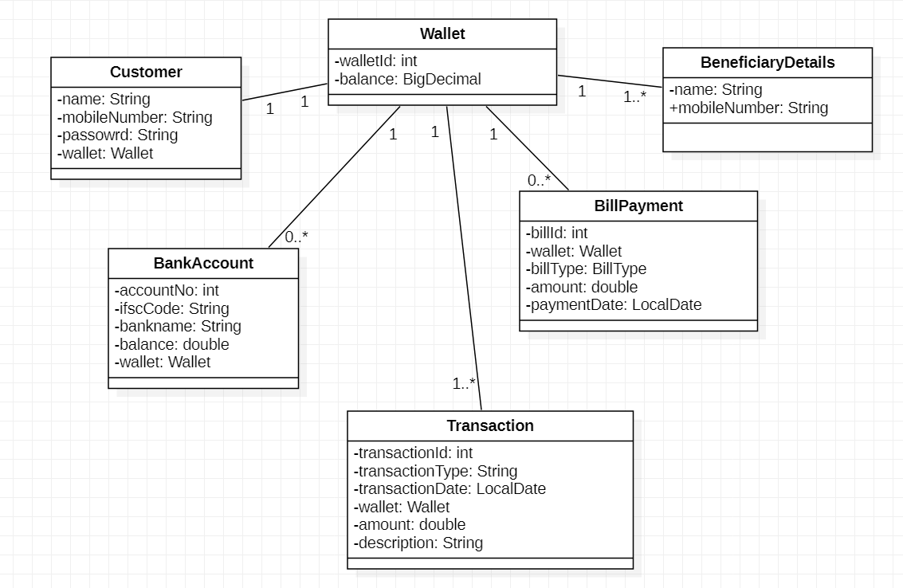
Class Design: POJO Classes

Slide 7
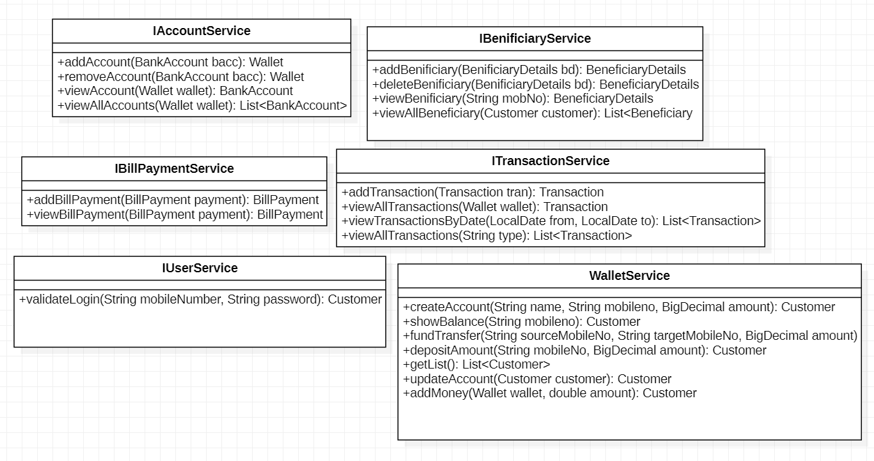
Class Design : Service Interface

Slide 8
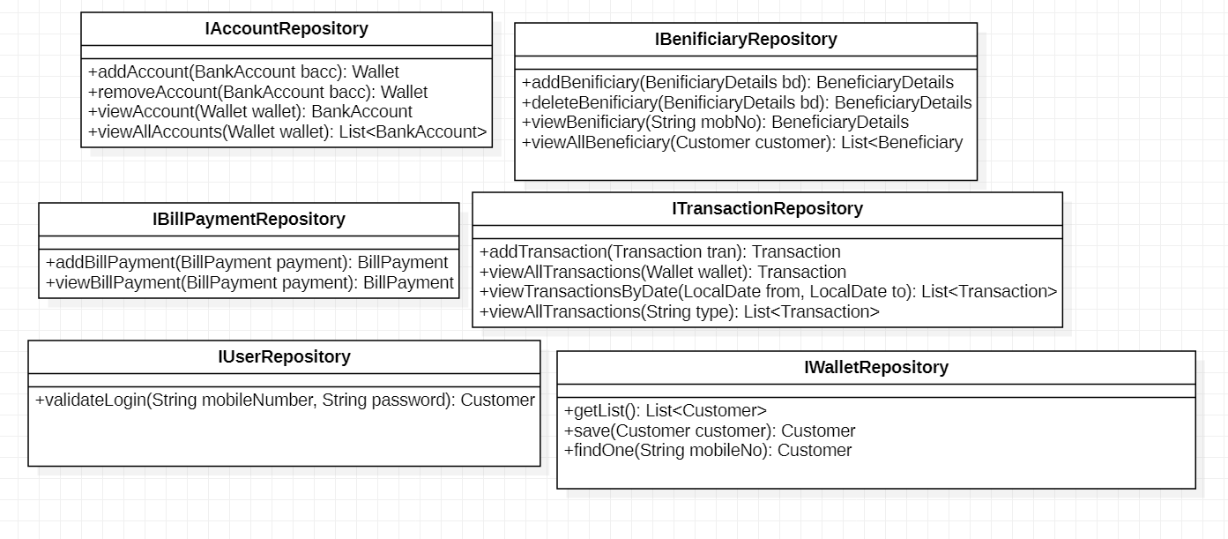
Class Design: Repository

Slide 9
Entity Relationship
Participants will identify and come up with ER diagram as part of the deliverables

Slide 10
UI- Wireframes
Participants will identify and come up with Wireframes as part of the deliverables

Slide 11
Other Requirements
Only authorized person should be able to access the application
Entire application should follow the microservices based architecture

